Slide 1
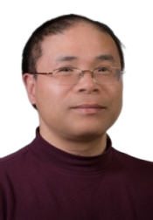


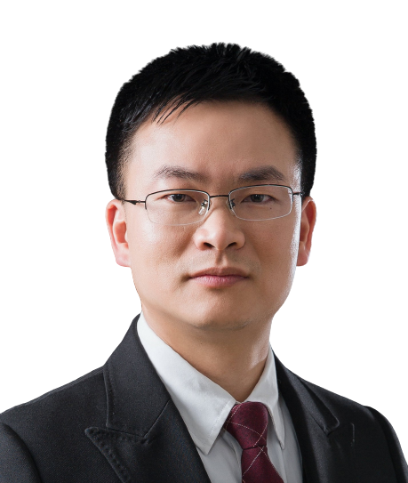
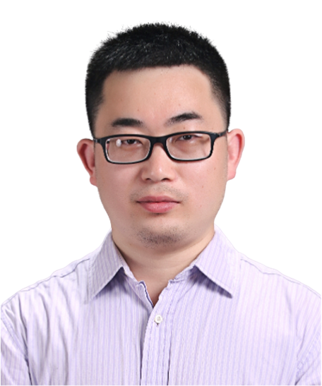
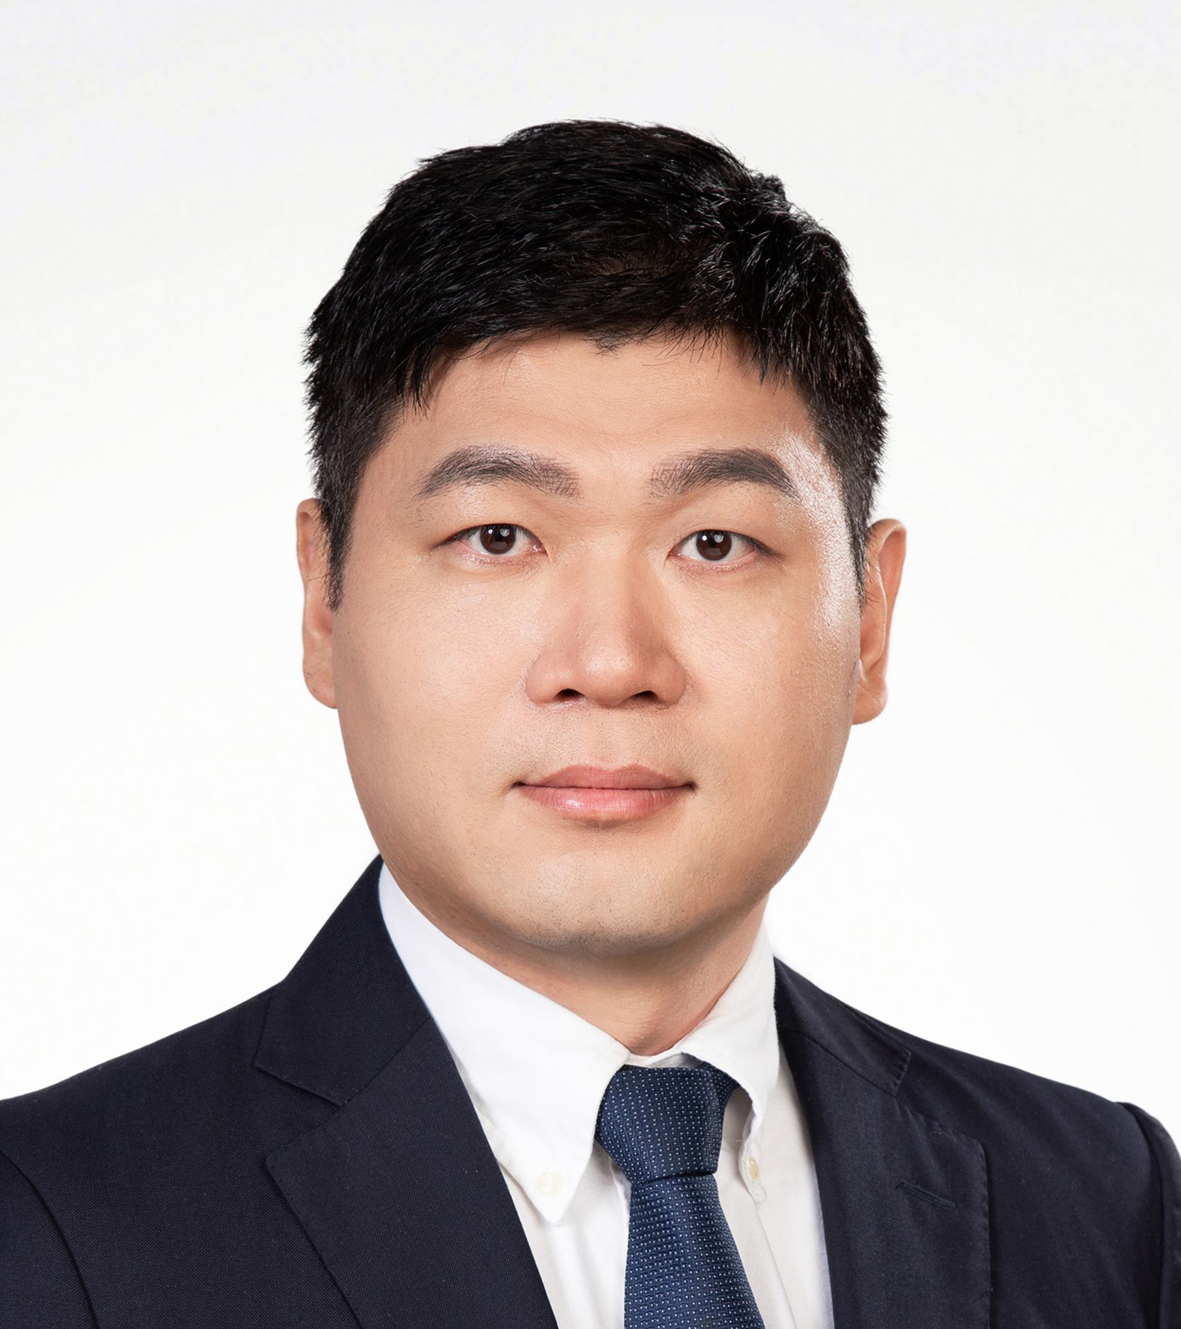
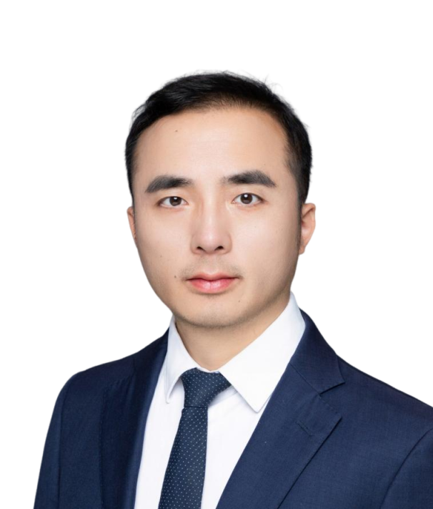

Advancing RNA Structure Prediction with Data-Driven Molecular Dynamics Simulations
Time (China): 2025-8-27 09:00 AM
Time(CDT): 2025-8-26 08:00 PM
Zoom ID: 839 5628 3221
Passcode: 123456
Zoom meeting link: https://us06web.zoom.us/j/83956283221?pwd=jkdf7vkwlivpb5vS2yhx0i8uTsInwC.1
Bilibili：https://live.bilibili.com/26427894
Shi-Jie Chen
University of Missouri
Abstract:
Emerging biomedical advances in precision medicine and synthetic biology highlight RNA’s central role as both a regulator and an information carrier. Because an RNA’s function is dictated by its 3D structure and the structural changes it undergoes, research in this area focuses on predicting the structure along with stability, kinetics, and interactions with metal ions and other molecules from the nucleotide sequence. Key questions include: How can the native fold be built from the sequence? For a given RNA target, how can RNA–small molecule interactions be predicted and potential drug candidates identified? Developing computational tools to address these questions remains challenging due to the limited RNA structural and binding data. To predict 3D structure from sequence, the Vfold pipeline was developed by integrating RNA structural data with statistical analysis and molecular dynamics simulations. This approach led to Vfold being ranked #1 in the RNA category at the international CASP16 (Critical Assessment of Structure Prediction) competition for biomolecular structure predictions. The model offers a useful resource for gaining structure-based insights into RNA function and for accelerating RNA-targeted therapeutic discovery.
HOST＆PANELISTS
Host：Lin Huang
Sun Yat-sen University
Jinkai Wang
Sun Yat-sen University
Zhichao Miao
Guangzhou Laboratory
Guangzhou Medical University
Peng Xiong
University of Science and Technology of China
Sponsors

Slide 2
利用数据驱动的分子动力学模拟
推进RNA结构预测
Time (China): 2025-8-27 09:00 AM
Time(CDT): 2025-8-26 08:00 PM
Zoom ID: 839 5628 3221
Passcode: 123456
Zoom meeting link: https://us06web.zoom.us/j/83956283221?pwd=jkdf7vkwlivpb5vS2yhx0i8uTsInwC.1
Bilibili：https://live.bilibili.com/26427894
陈世杰
教 授
美国密苏里大学
简介：
陈世杰 (Shi-Jie Chen) 博士，是密苏里大学 (University of Missouri) 生物物理学、生物化学以及数据科学与信息学的杰出教授 (Curators’ Distinguished Professor)。本科毕业于浙江大学，并通过李政道先生的中美联合招考物理研究生项目 (CUSPEA) 进入加州大学圣地亚哥分校 (University of California, San Diego) 学习，并获得物理学博士学位。随后，他在加州大学旧金山分校 (University of California, San Francisco) 的药物化学系从事博士后研究。
陈教授因其在 RNA 折叠方面的研究当选为美国物理学会 (APS) 和美国科学促进会 (AAAS) 会士 (Fellow)。他担任 PLOS Computational Biology、MLHealth 和RNA NanoMedicine 的副主编 (Associate Editor)，以及The Journal of Biological Chemistry 的编委会成员 (Editorial Board Member)。他也是国际 RNA 纳米技术与纳米医学学会 (International Society of RNA Nanotechnology and Nanomedicine) 的创始理事会成员 (Founding Council Member)。
他的研究专注于 RNA 折叠与治疗的计算生物学。他在 RNA 结构预测、模拟 RNA-离子及 RNA-小分子相互作用，以及设计基于 RNA 的疗法方面的工作享有盛誉。
主持人＆嘉宾
主持人：黄林
中山大学孙逸仙纪念医院
王金凯
中山大学
苗智超
广州国家实验室
广州医科大学
熊鹏
中国科学技术大学
赞助商

